Slide 1

Temperature Prediction Using Time-Series
and Deep Learning Models
1.TSA Regression of Temperature
2.TSA Classification of Conditions
Deep Learning CE561
Data Gathering, Data preprocessing, RNN/LSTM
Basel Al-Dwairi 20221502065
Omar Alamssi 20229502031

Slide 2
Project Overview
Problem:
Predicting hourly temperature and classifying weather conditions is essential for planning daily activities, agriculture, and safety measures. Traditional forecasting methods often fail to capture complex temporal patterns in weather data.
Objective:
The goal of this project is to apply Deep Learning models, specifically RNN and LSTM, to accurately predict temperature and classify weather conditions using historical hourly weather data. The model should learn temporal dependencies and seasonal patterns to make near-real-time predictions.

Slide 3
Pipeline & Importantce
  Helps improve short-term weather forecasts.
  Enables better planning for outdoor events and transportation.
  Demonstrates the effectiveness of sequence-based deep learning in time-series applications.
Historical Weather Data
Preprocessing
RNN/LSTM
Regression/Classification

Slide 4
Data Collection
Source:
  Data collected from Weather Underground API for Amman, Jordan.
  Dataset contains hourly measurements from 2010 to 2025.
Features:
  Temperature (°C) – Target for regression
  Dew Point (°C)
  Wind Speed (mi/h)
  Wind Direction (deg)
  Gust
  Pressure (hPa)
  Weather Condition (Sunny, Cloudy, Rainy, etc.) – Target for classification
Data Size:
  Total rows: ~140,000+ (hourly data for 15 years)
  Columns: 7 main features + datetime

Slide 5
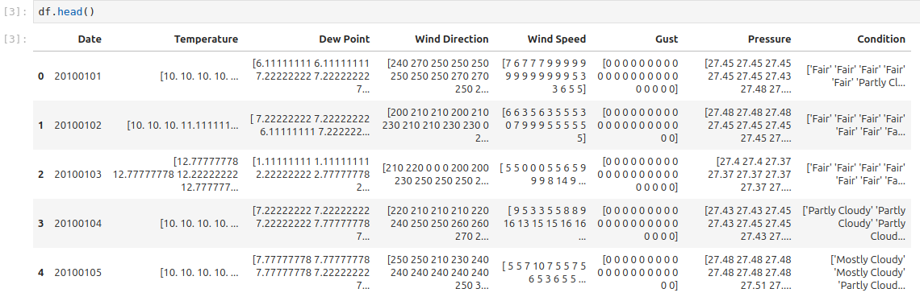
Data Collection - Cont
Data Reliability:
  Official weather API ensures high credibility.
  Continuous hourly measurements allow capturing temporal patterns accurately.
  https://www.wunderground.com

Slide 6
Data Preprocessing & Cleaning
Steps Taken:
  Collapsing Collected Daily Data into Hourly Data
  Handling Missing Values
    Checked for null or missing entries in each column.
    Filled missing temperature values using forward-fill method.
  Removing Duplicates
    Ensured no duplicate datetime entries exist.
  Correct Data Types
    Converted Datetime column to datetime type for easier manipulation.
  Sorting Data
    Sorted dataset by datetime to maintain temporal order.
  EDA
    Visalization
    Data Cleanup
  Data Preprocessing
    Handling Outliers in Temperature and Wind Speed
    One-Hot encoding Categorical Data
    Normalization (MinMax)
    Wind Direction (degrees → sine and cosine)

Slide 7
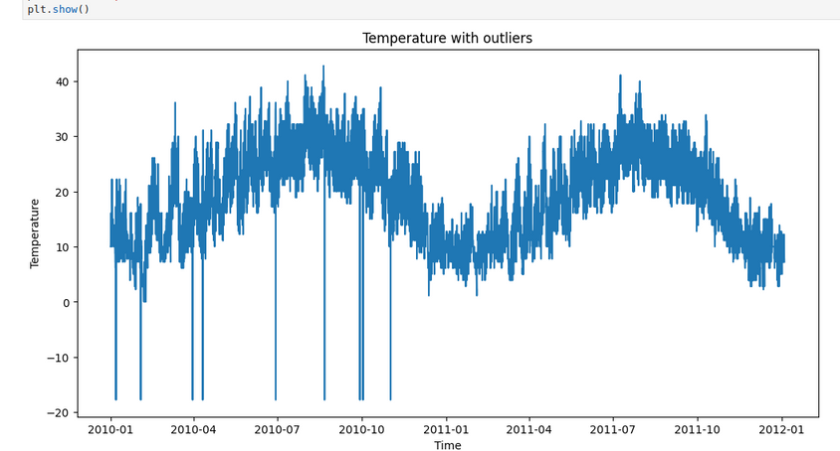
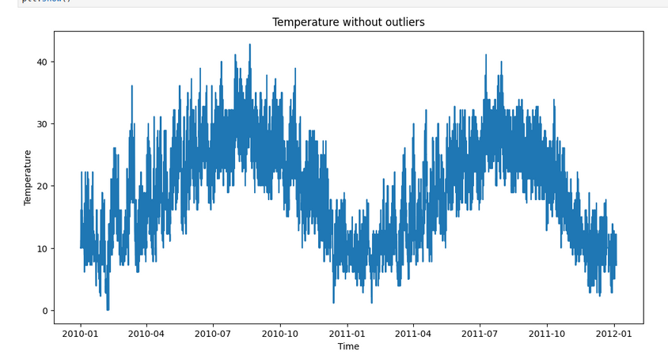
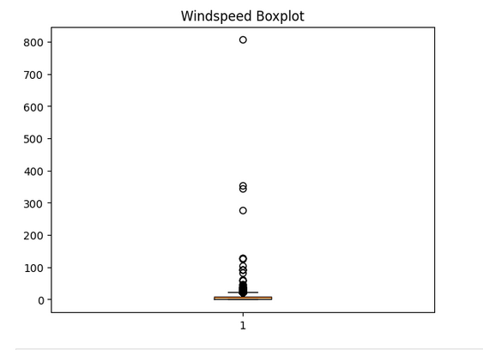
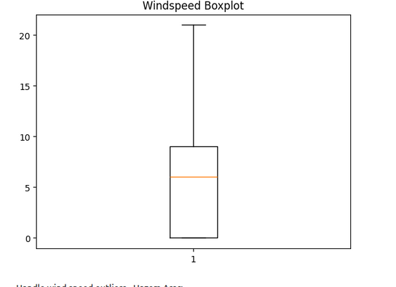
Data Preprocessing & Cleaning

Slide 8
Feature Engineering
THE MODELS USED SLIDING WINDOW FOR CREATING SEQUENCES FOR TRAINING AND TESTING
The Neural Networks used the following features:
  Temperature
  Wind direction_sin
  Wind direction_cos
  Wind Speed
  One-hot encoded Conditions (Classification only)
Target:
  Termperature (Regression)
  One-hot encoded Conditions (Classification)

Slide 9
Model Building (Regression)
MODEL CHOICE:
  RNN (SIMPLE RECURRENT NEURAL NETWORK): CAPTURES TEMPORAL DEPENDENCIES IN SEQUENTIAL DATA.
  LSTM (LONG SHORT-TERM MEMORY): HANDLES LONG-TERM DEPENDENCIES BETTER, REDUCES VANISHING GRADIENT PROBLEM.
ARCHITECTURE:
  INPUT LAYER: SEQUENCE OF PREVIOUS VALUES (WINDOW).
  HIDDEN LAYERS:
    RNN / LSTM LAYER WITH 64 UNITS, TANH ACTIVATION FOR RNN AND LSTM.
  OUTPUT LAYER: DENSE LAYER WITH 1 UNIT FOR TEMPERATURE PREDICTION WITH LINEAR ACTIVATION.

Slide 10
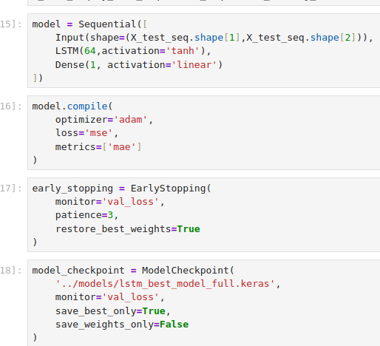
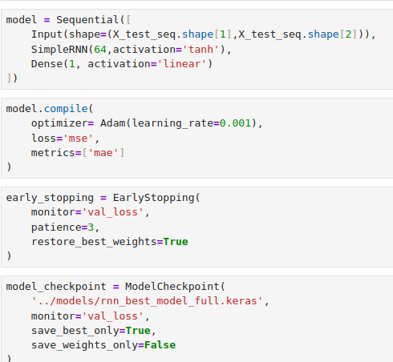
Training Models (Regression)
Training Details:
  Loss Function: Mean Squared Error (MSE)
  Optimizer: Adam
  Max Epochs: 25
  Batch Size: 32
  Window size 24 - 72 hours
  learning rate 0.001
  Early stopping and model checkpoint
LSTM
RNN

Slide 11


Evaluation & Results (Regression)
Metrics that were used:
  MAE
  MSE
  R2

Slide 12
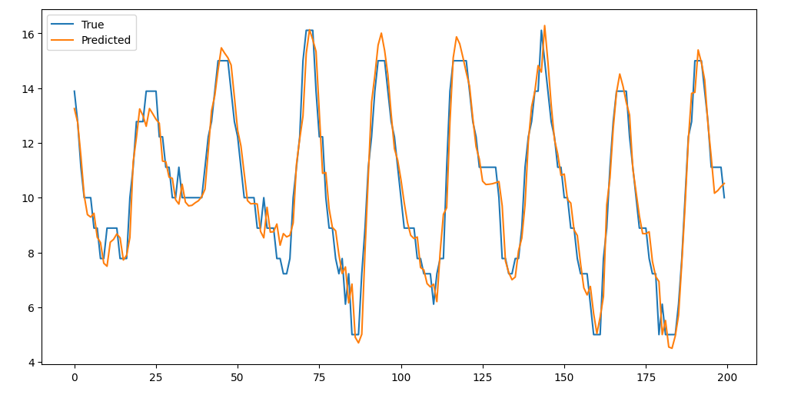
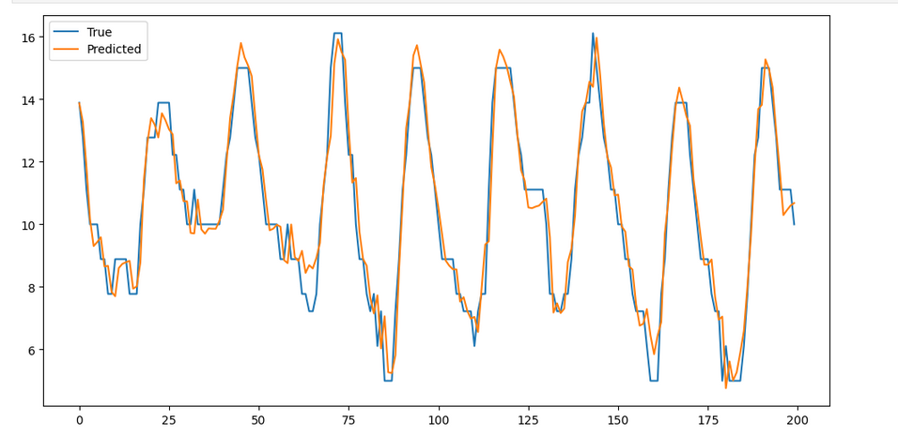
Visualization (Regression)
  Models tracks temperature trends very closely.
  Small residual errors mainly occur during sudden spikes or drops.
  LSTM slightly outperforms simple RNN due to its ability to capture long-term dependenc
RNN
LSTM

Slide 13
Model Building (Classification)
MODEL CHOICE:
  LSTM (LONG SHORT-TERM MEMORY): HANDLES LONG-TERM DEPENDENCIES BETTER, REDUCES VANISHING GRADIENT PROBLEM.
ARCHITECTURE:
  INPUT LAYER: SEQUENCE OF PREVIOUS FEATURES (WINDOW).
  HIDDEN LAYERS:
    LSTM LAYER WITH 64 UNITS, TANH ACTIVATION FOR LSTM.
  OUTPUT LAYER: DENSE LAYER WITH A UNIT PER CONDITION (32 IN TOTAL) WITH SOFTMAX ACTIVATION FUNCTION.

Slide 14
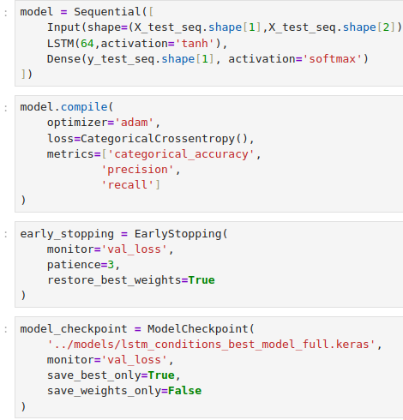
Training Models (Classification)
LSTM
Training Details:
  Loss Function: Categorical Crossentropy
  Optimizer: Adam
  Max Epochs: 25
  Batch Size: 32
  Window size 24 - 72 hours
  learning rate 0.001
  Early stopping and model checkpoint

Slide 15
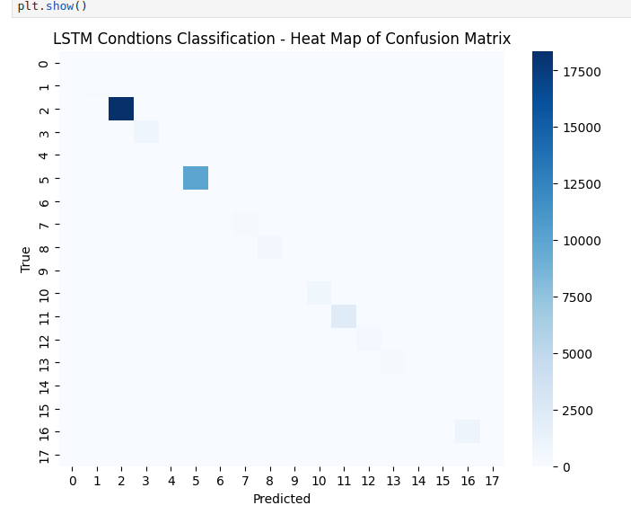

Evaluation & Results (Classification)
Metrics that were used:
  Precision
  Recall
  F1 score
  Confusion Matrix

Slide 16
Conclusion & Key Takeaways
Regression
  The RNN and LSTM models successfully captured the temporal patterns in temperature data.
  LSTM slightly outperformed simple RNN due to better handling of long-term dependencies.
  TSA feature engineering (lag features, hour of day) significantly improved prediction accuracy.
  The models achieved high R² and low RMSE, indicating reliable predictions.
  Future improvements:
    Experiment with additional features (e.g., weather conditions, humidity).
    Tune hyperparameters for further optimization.
    Consider hybrid models combining TSA features with deep learning.
    Longer window for TSA

Slide 17
Conclusion & Key Takeaways
Classification
  The classification model performed poorly: Precision, Recall, F1-score ≈ 0.375.
  Confusion matrix shows many misclassifications across classes.
  Likely causes of failure:
    Insufficient or imbalanced data for certain weather conditions.
    Hardware and time Limitations
    Model complexity may be too low for multi-class prediction.
  Next steps to improve:
    Collect more labeled data or balance the dataset.
    Add more features like humidity, gust, or pressure.
    Experiment with deeper models (LSTM/1D-CNN/Transformers and Attention) or ensemble methods.

Slide 18
Thank you for your attention!
Any questions?
Github: https://github.com/Basel-Aldwairi/Temperature_TSA

